Slide 1
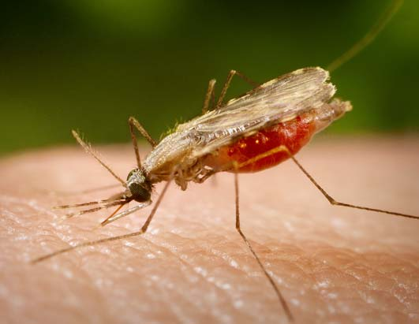
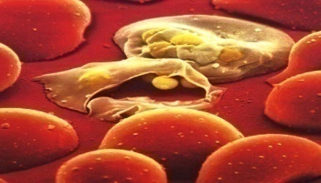
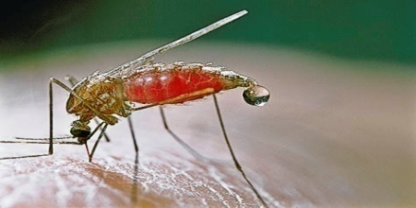
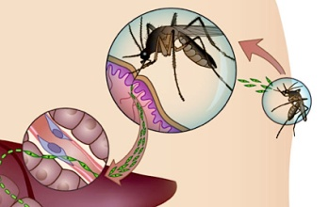
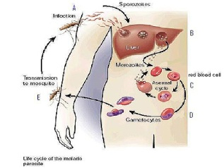
Inﬂuence of climate on malaria transmission depends on daily temperature variation
Krijn P. Paaijmans , Simon Blanford , Andrew S. Bell , Justine I. Blanford , Andrew F. Read , and Matthew B. Thomas.
Presented by
P.B.TiRUPATHI PICHIAH
Ph.D., Student
Dept Of Human Nutrition

Slide 2
Lets First Understand What is Malaria?
Malaria is a mosquito-borne infectious disease caused by a eukaryotic protist of the genus Plasmodium.
Widespread in tropical and subtropical regions, including parts of the Americas (22 countries), Asia, and Africa.
250 million cases of malaria/year
Major affected area : sub-Saharan Africa
Commonly associated with poverty

Slide 3
History Of Malaria
First described in India during Vedic Period 1600BC and by Hippocrates some 2500 years ago.
Charaka and Sushrutha gave vivid descriptions of malaria and even associated it with the bites of the mosquitoes.
In 1640, Huan del Vego first employed the tincture of the cinchona bark for treating malaria, although aborigines of Peru and Ecuador had been using it even earlier for treating fevers.
Morton (1696) presented the first detailed clinical picture of malaria and its treatment with cinchona.
Lancisi (1717) linked malaria with poisonous vapours of swamps and thus originated the name malaria, meaning bad air
Gize (1816) studied extraction of quinine from the cinchona bark.
Pelletier and Caventou (1820) extracted pure quinine alkaloids

Slide 4
Laveran (1880) a French physician working in Algeria, first identified the causative agent for human malaria while viewing blood slides under a microscope.
P.vivax and P.malariae were identified in 1885 by Golgi
Sakharov (1889) and Marchiafava and Celli (1890) identified P.falciparum
Sir Ronald Ross (1897) while working as a military physician in India, demonstrated the malarial oocysts in the gut tissue of female Anopheles mosquito. This was reported in the British Medical Journal.
Paul Muller (1939) discovered the insecticidal properties of DDT.
Curd, Davey and Rose (1944) synthesised proguanil for treating falciparum malaria
During the World War II research into antimalarials was intensified.
Chloroquine was synthesised and studied under the name of Resochin by the Germans as early as 1934

Slide 5
Short, Granham, Covell and Shute (England) identified tissue forms of P.vivax in the liver. Tissue stages of P. falciparum, P. ovale, and P. malariae were also identified later on.
Elderfield (1950, USA) synthesised primaquine.
Lysenko (1976-78) formulated a theory on the polymorphism of P.vivax sporozoites.
Bray and Garnham (1982) proposed that some sporozoites in the liver remain latent (hypnozoites) causing relapses later on.
Quinine has now been completely synthesized. Its synthetic analogue is called mefloquine..
In 1967, WHO realized that the global eradication of malaria was impossible for a variety of reasons and the focus shifted to control of the disease.

Slide 6
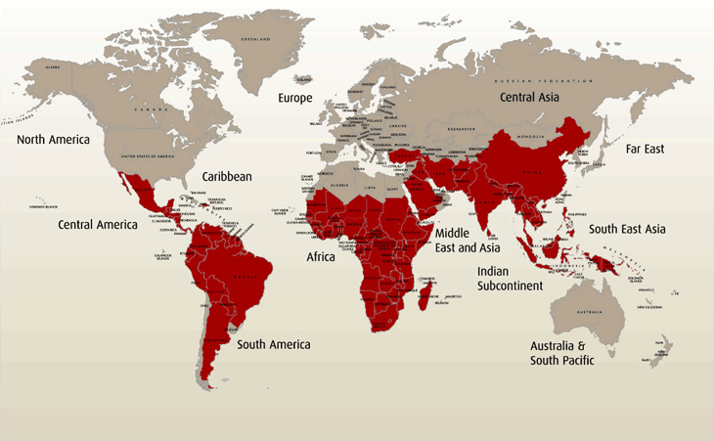
Geographic Locations
60
30
0
30
60

Slide 7
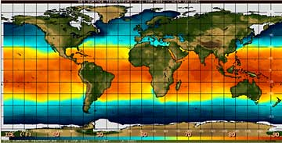
Global Temperature Map

Slide 8
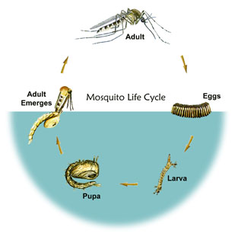
Life cycle of Malaria Vector:
YouTube
Movie

Slide 9
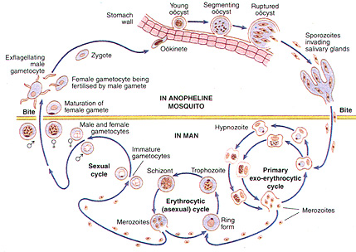
Life Cycle Of Malaria Parasite
YouTube
Part 1
Part2
Video
Part 1
Part 2

Slide 10
Climate and Malaria
The three main climate factors that affect malaria are temperature, precipitation, and relative humidity (Pampana, 1969).
Climate predicts, to a large degree, the natural distribution of malaria (Bouma and van der Kaay, 1996).
Temperature
Temperature affects many parts of the malaria life cycle.
The duration of the extrinsic phase depends on temperature and on the species of the parasite the mosquito is carrying (Pampana, 1969).
The extrinsic cycle normally lasts nine or ten days, but sometimes can be as short as five days (Bradley et al., 1987).
As the temperature decreases, the number of days necessary to complete the extrinsic cycle increases for a given Plasmodium species.

Slide 11
P. vivax and P. falciparum have the shortest extrinsic incubation times and therefore are more common than P. ovale and P. malariae (Oaks et al., 1991).
The extrinsic phase takes the least amount of time when the temperature is 27°C (Pampana, 1969).
The time required for development of the ookinete, the egg of the parasite, in the midgut of the Anopheline mosquito, decreases as temperature increases from 21°C to 27°C (Patz et al., 1998).
Below 20°C, the life cycle of falciparum is limited. Malaria transmission in areas colder than 20°C can still occur because Anophelines often live in houses, which tend to be warmer than external temperatures.
Larval development of the mosquito also depends on temperature (Russell et al., 1963). Higher temperatures increase the number of blood meals taken and the number of times eggs are laid by the mosquitoes (Martens et al., 1995).

Slide 12
The intersections of the ranges of minimum and maximum temperature for parasite and vector development determine the impact of changes in temperature on malaria transmission.
The minimum temperature for mosquito development is between 8-10°C, the minimum temperatures for parasite development are between 14-19°C with P. vivax surviving at lower temperatures than P. falciparum.
The optimum temperature for mosquitoes is 25-27°C, and the maximum temperature for both vectors and parasites is 40°C (McMichael et al., 1996). There are some areas where the climate is optimal for malaria and Anopheles mosquitoes are present, but there is no malaria.
This is called “Anophelism without malaria” which can be due to the fact that the Anopheles mosquitoes present do not feed primarily on humans (Bruce-Chwatt, 1985) or because malaria control techniques have eliminated the parasite .

Slide 13
Precipitation
Anopheline mosquitoes breed in water habitats, thus requiring just the right amount of precipitation in order for mosquito breeding to occur.
Different Anopheline mosquitoes prefer different types of water bodies in which to breed (Nagpal and Sharma, 1995).
Too much rainfall, or rainfall accompanied by storm conditions can flush away breeding larvae.
Not only the amount and intensity of precipitation, but also the time in the year, whether in the wet or dry season, affects malaria survival (Russell et al., 1963).
Rainfall also affects malaria transmission because it increases relative humidity and modifies temperature, and it also affects where and how much mosquito breeding can take place (Pampana, 1969).

Slide 14
Relative Humidity
Relative humidity also affects malaria transmission.
Plasmodium parasites are not affected by relative humidity, but mosquitoes are.
If the average monthly relative humidity is below 60%, it is believed that the life of the mosquito is so shortened that there is no malaria transmission (Pampana, 1969).
Wind
Wind may play both negative and positive roles in the malaria cycle because very strong winds can decrease biting or ovipositing by mosquitoes, while at the same time extending the length of the flight of the mosquito.
During a monsoon, wind has the potential to change the geographic distribution of mosquitoes (Russell et al., 1963).

Slide 15
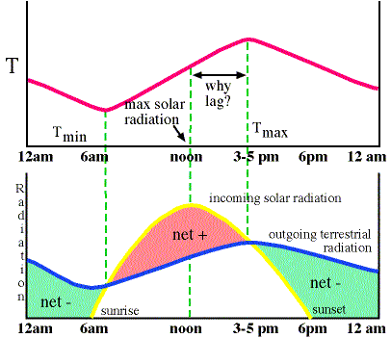
Daily Temperature Variations - Net Radiation
Diurnal temperature variation is a meteorological term that relates to the variation in temperature that occurs from the highs of the day to the cool of nights.
The net radiation determines whether the surface temperature rises, falls, or remains the same.
net radiation = incoming solar - outgoing IR.
If the net radiation > 0, surface warms ( 6 AM - 3-5 PM)
if the net radiation < 0, surface cools (3-5 PM - 6 AM)

Slide 16
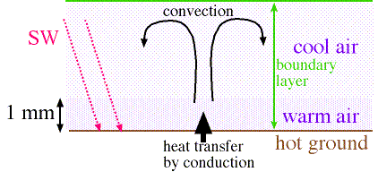
Factors Affecting Daytime Warming - Fundamental Process.
Heat is transported from the hot surface to air molecules very near the hot surface by conduction.
Heat is then transported further upward by convection - thermals of air.
The layer of air near the earth's surface where most of the daily temperature variation occurs as a result of the heating/cooling of the ground is called the boundary layer (1-1.5Km)

Slide 17
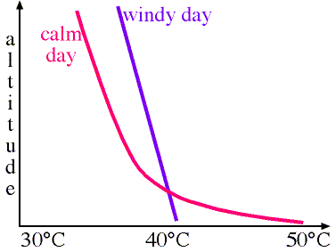
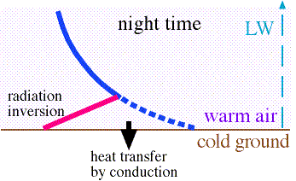
Factors Affecting Daytime Warming
Night time cooling - radiation inversion
During the night time hours, there is no SW heating the ground, so the ground cools rapidly.
hence, there is heat transfer by conduction from the warm air to the cold ground.
This heat transfer occurs in a shallow layer near the ground since air is a poor conductor
a "radiation inversion" is formed: a shallow layer of air near the earth's surface where the temperature increases with height
average radiation inversion depth is about 100m, but can vary from 10m - 1 km
wind speed
land type
humidity
vegetation cover
soil moisture
cloudiness

Slide 18
From the Paper:
Reproductive number (R₀ ),
R₀ = ma ² bce^{−pS} /pr
where,
m = vector:human ratio,
a = vector biting frequency,
bc = transmission coefficients deﬁning vector competence,
p = daily vector survival rate,
S= the extrinsic incubation or development period of the parasite within the vector, and
r=recovery rate of the vertebrate hosts from infection.
These parameters relate in some way to mosquito abundance, its biology, or physiology

Slide 19
Aim:
Role of temperature (constant and fluctuating) in
Growth and dissemination of the P.chabuadi inside the mosquito.
Survival rate of mosquito larva.
Gonotropic cycle * length of female mosquitoes.
* The complete cycle from time of feeding to oviposition (Covell et al 1953).

Slide 20
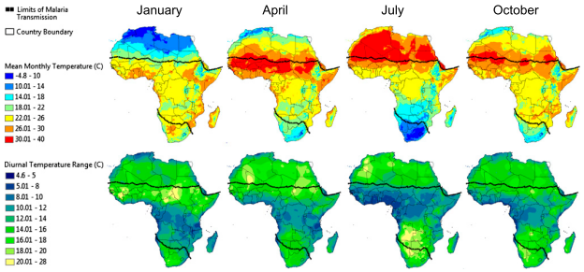
Results and Discussion
Fig1. Mean monthly temperature and mean monthly DTR throughout Africa for January, April, July, and October. Temperature surfaces were generated by interpolation using weather station data collected between 1960 and1990. For areas where data records were limited, such as in the Democratic Republic of the Congo, the time period was extended to 2000. The current geographical limits of malaria transmission are illustrated by the dotted lines.

Slide 21
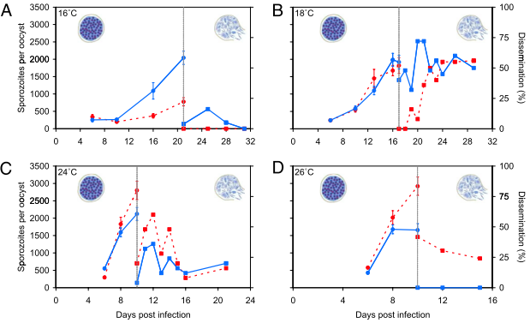
Growth rate and dissemination of P. chabaudi malaria in An. stephensi mosquitoes under constant and ﬂuctuating temperature regimens. Constant temperatures (dashed red lines) or temperatures with a diurnal temperature ﬂuctuation of ±6 °C (DTR = 12 °C; solid blue
lines).

Slide 22
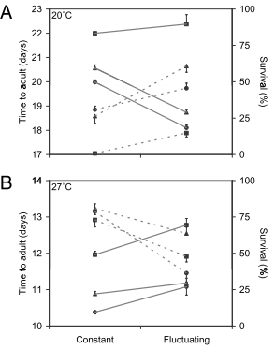
Fig. 3 Interaction plot of the development time and survival of the immature stages of An. stephensi under constant compared with ﬂuctuating temperature regimens.
(A) Development time (days, solid lines) and survival
(percentage, dashed lines) of mosquito immatures until they reached the adult stage at a constant 20 °C and at a mean temperature of 20 °C but with a diurnal temperature ﬂ uctuation of ±6 °C (DTR = 12 °C).
(B) Data from an equivalent experiment at 27 °C. Results are given for three different larval densities (■, 0.5, ▲, 1, and • , 2 larvae/cm 2 ).

Slide 23
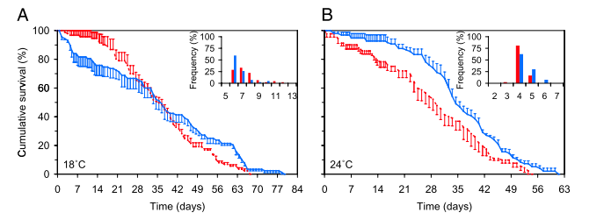
Fig. 4. Cumulative percent survival and gonotrophic cycle length of female An. stephensi mosquitoes under constant and ﬂuctuating temperature regimens.
Survival at constant 18 °C (dashed red line) compared with survival at a mean temperature of 18 °C but with a diurnal temperature ﬂuctuation of ±6 °C (DTR = 12 °C; closed blue line). (Inset) The percentage of mosquitoes that completed the gonotrophic cycle on a given day (on the x axis) at constant 18 °C (red bars) compared with completion at a mean temperature of 18 °C but with a diurnal temperature ﬂuctuation of ±6 °C (DTR = 12 °C; blue bars).
(B) Data from equivalent experiments at 24 °C.

Slide 24
The key mosquito-related traits that combine to determine malaria transmission intensity are all sensitive to daily variation in temperature.
ie
parasite infection,
parasite growth and development,
immature mosquito development and survival,
Length of the gonotrophic cycle, and adult survival.
Temperature fluctuation increases relative rate processes under cool conditions and
slows rate processes under warm conditions.

Slide 25
Limitations:
Used rodent malaria and one species of mosquito need to extend investigations to human malaria species and to other important vectors.
These ﬁndings caution against standard practice in studies estimating mosquito and/or malaria climate relations and strengthen arguments for greater ecological understanding of how infectious organisms respond to the natural environment.
What we learn?
Daily temperature ﬂuctuation on basic aspects of insect and parasite life histories suggest the need to consider the role of temperature variation for many ectotherms (other insects, amphibians, reptiles, etc.) and their parasites and pathogens,
both for understanding current biology and the likely impacts of climate change

Slide 26
Some Interesting Facts

Slide 27
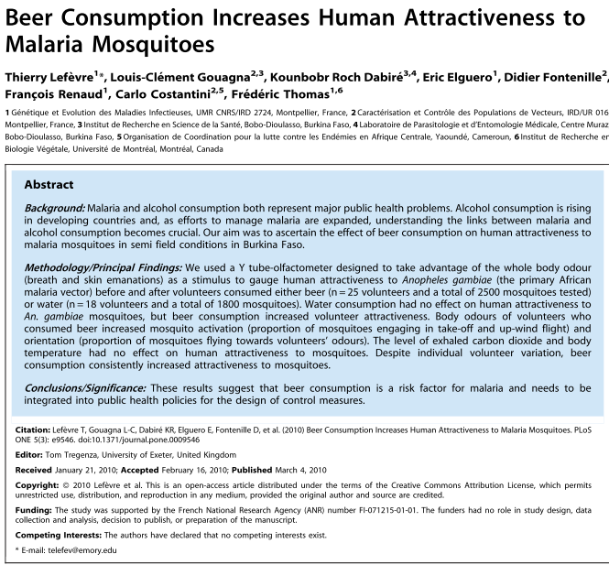

Slide 28
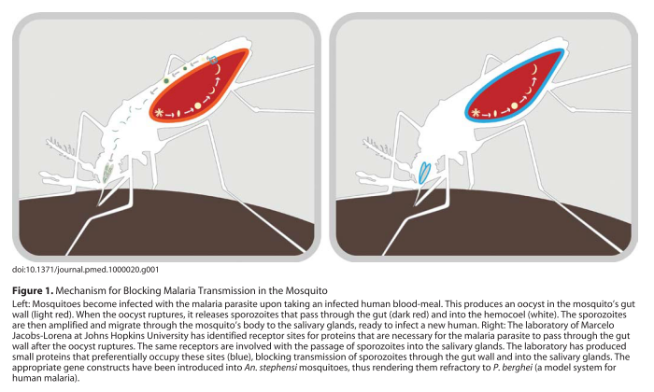

Slide 29
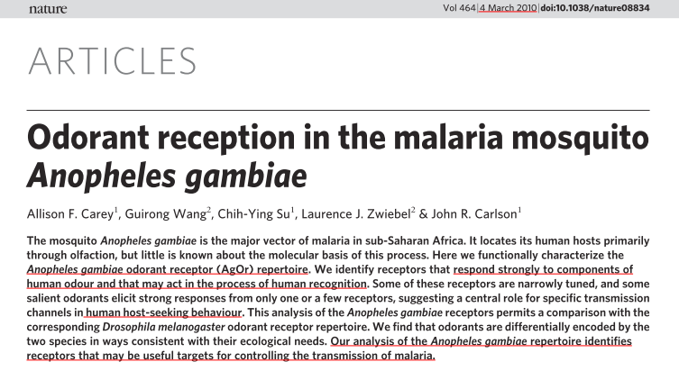

Slide 30
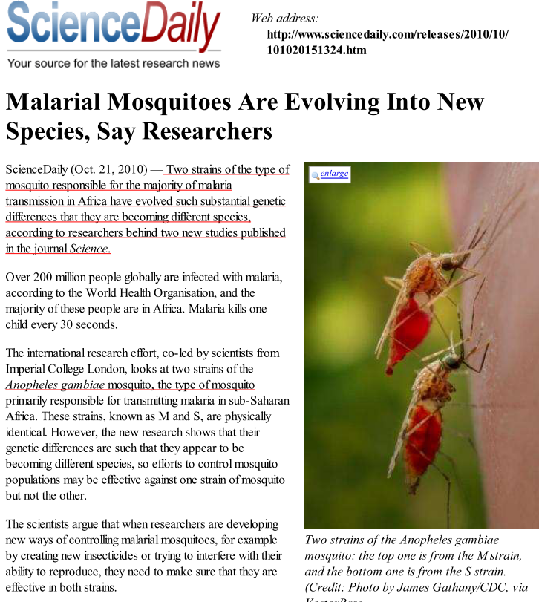

Slide 31
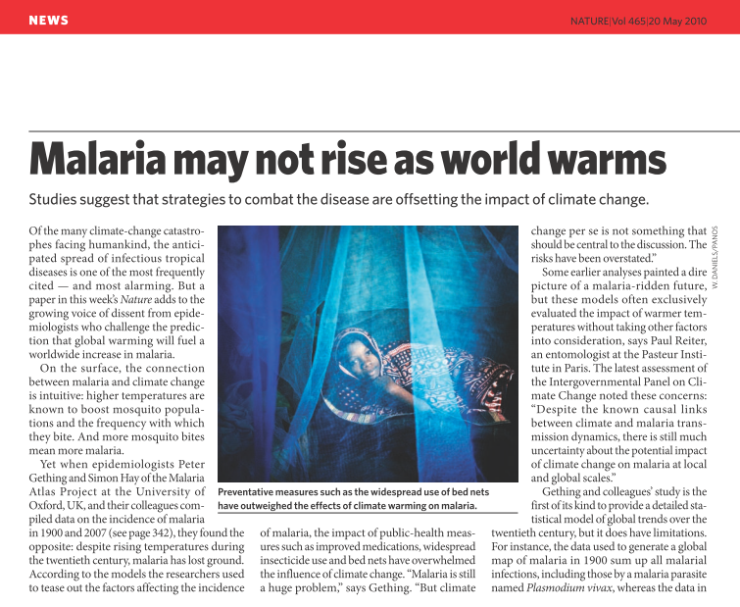

Slide 32
Thank You

